Slide 1
MAGNETOMETER-LESS STATE-ESTIMATION OF A MOBILE ROBOT USING CASCADED KALMAN FILTERS
By Tommy Le
Advisor: Dr. Ji-Chul Ryu 10/13/2023

Slide 2
Outline
Introduction
Previous Work
Objective
Framework
Preprocessing methods
Mobile Robot Extended Kalman Filter
IMU Extended Kalman Filter
Simulation Results
Remaining Work

Slide 3
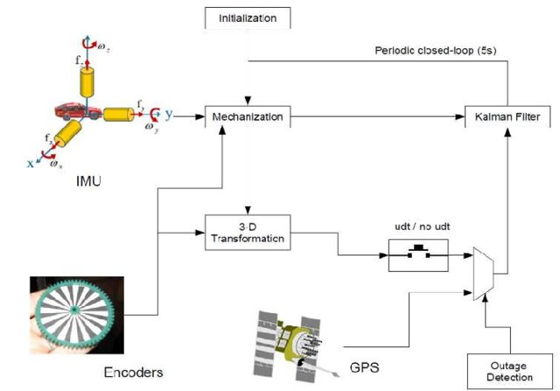
Background
Mobile robot localization
Outdoor
GPS
Indoor
Magnetometer, UWB
Both
Encoders, vision systems
Common Outdoor Localization Framework [1]
[1] E. North, J. Georgy, M. Tarbouchi, U. Iqbal and A. Noureldin, “Enhanced Mobile Robot Outdoor Localization Using INS/GPS Integration,” IEEE Explore, Jan. 2010.

Slide 4
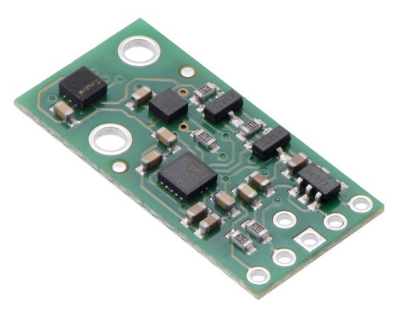
Background
Inertial Measurement Units (IMUs)
Tri-axial accelerometer, gyroscope
Sometimes magnetometer
Used for pose information
Errors
Accelerometer has high frequency noise
Gyroscope suffers from drift
Pololu 10 DOF IMU [2]
[2] “Pololu - AltIMU-10 v5 Gyro, Accelerometer, Compass, and Altimeter (LSM6DS33, LIS3MDL, and LPS25H Carrier),” www.pololu.com. https://www.pololu.com/product/2739 (accessed Oct. 09, 2023).
‌

Slide 5
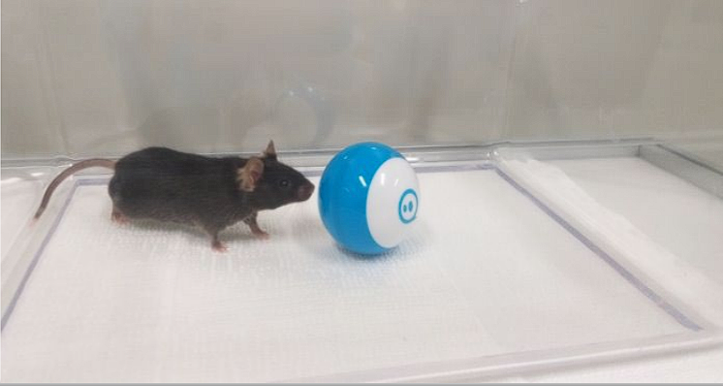
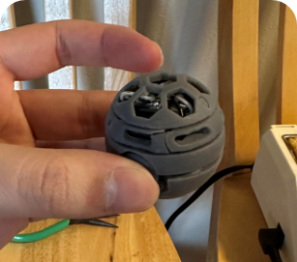
Motivation
Desire small spherical robot for indoor navigation
Experiments with common lab animals
Magnetometer suffered due to placement of motors
Other sensors do not fit size requirement

Slide 6
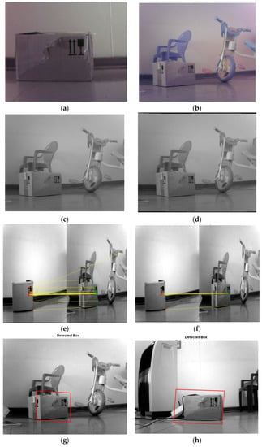
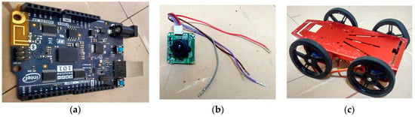
Previous Work
Pose Estimation of a Mobile Robot Based on Fusion of IMU Data and Vision Data Using an Extended Kalman Filter [3]
Object recognition and feature matching
State transition matrices are IMU and vision
4 wheeled mobile robot
[3] M. Alatise and G. Hancke, “Pose Estimation of a Mobile Robot Based on Fusion of IMU Data and Vision Data Using an Extended Kalman Filter,” Sensors, vol. 17, no. 10, p. 2164, Sep. 2017, doi: https://doi.org/10.3390/s17102164.
‌

Slide 7
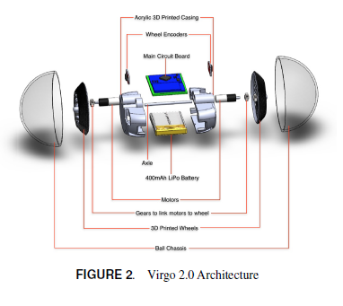
Previous Work
Localization and Trajectory Tracking of an Autonomous Spherical Rolling Robot Using IMU and Odometry [4]
Encoders
Requires wheel odometry
Magnetometer
Larger robot to isolate magnetic distortion
Dead reckoning for localization
[4] V. Ajay, A. Suherlan, G. Soh, S. Foong, K. Wood and K. Otto, “Localization and trajectory Tracking of an Autonomous Spherical Rolling Robot using IMU and Odometry ,” ASME, Aug. 2015.‌

Slide 8
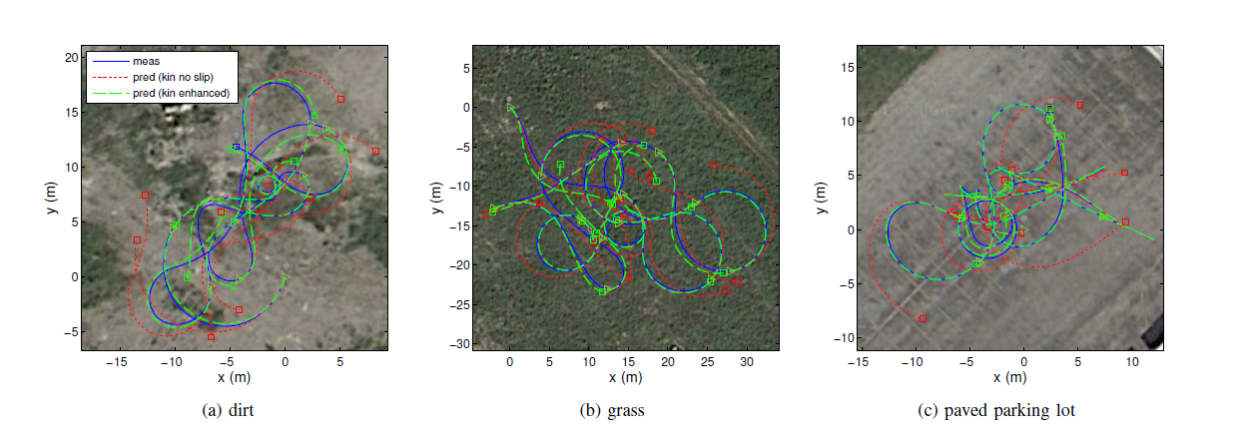
Previous Work
Enhanced 3D Kinematic Modeling of Wheeled Mobile Robots [5]
No real-time implementation
Able to provide robust estimation with just a kinematic model
[5] A. Kelly and N. Seegmiller, “Recursive kinematic propagation for wheeled mobile robots,” The International Journal of Robotics Research, vol. 34, no. 3, pp. 288–313, Jan. 2015, doi: https://doi.org/10.1177/0278364914551773.

Slide 9
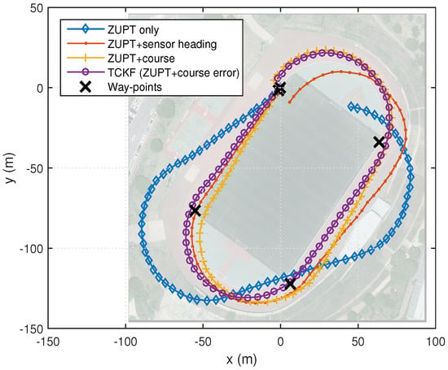
Previous Work
Enhanced Pedestrian Navigation Based on Course Angle Error Estimation Using Cascaded Kalman Filters [6]
IMU to estimate pedestrian pose
INS-PDR-EKF
Magnetometer course correction
Cascaded KF framework
[6] J. Song and C. Park, “Enhanced Pedestrian Navigation Based on Course Angle Error Estimation Using Cascaded Kalman Filters,” Sensors, vol. 18, no. 4, p. 1281, Apr. 2018, doi: https://doi.org/10.3390/s18041281.

Slide 10
Objectives
Develop a robust magnetometer-less state estimation algorithm using only IMU data
Design the algorithm so it can incorporate additional sensor data to improve estimation

Slide 11
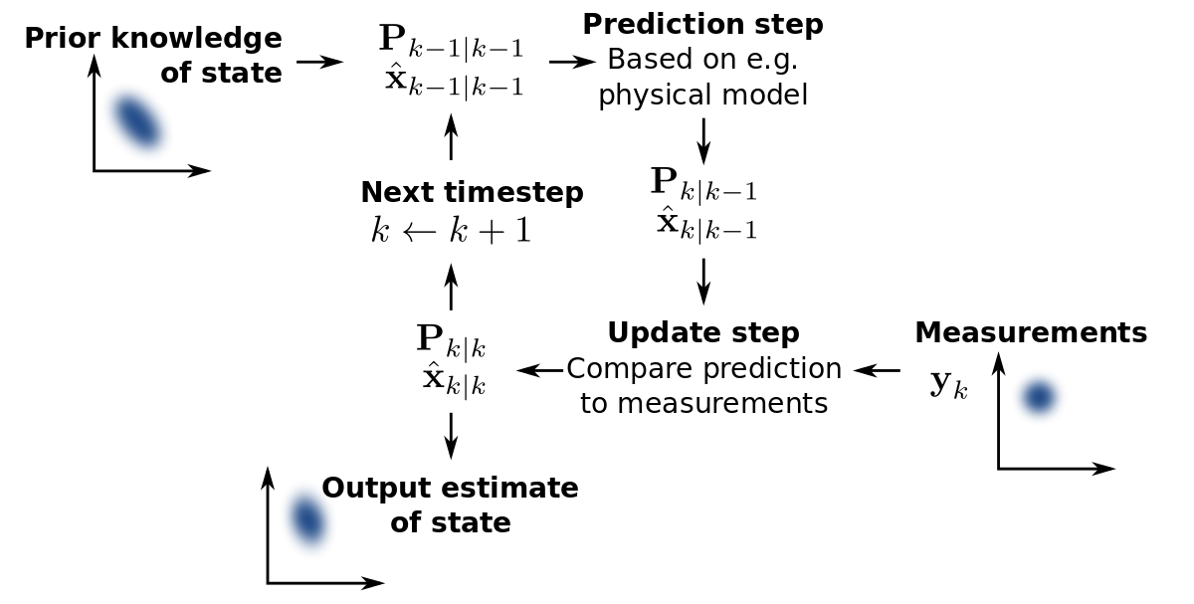
Kalman Filter Review
Kalman Filter
Designed for linear systems
Follows predict and update model
Applications
Pose estimation
Economics
Weather forecasting
Kalman Filter Flow Chart [7]
[7] W. Franklin, “Kalman Filter Explained Simply,” The Kalman Filter, Dec. 31, 2020. https://thekalmanfilter.com/kalman-filter-explained-simply/

Slide 12
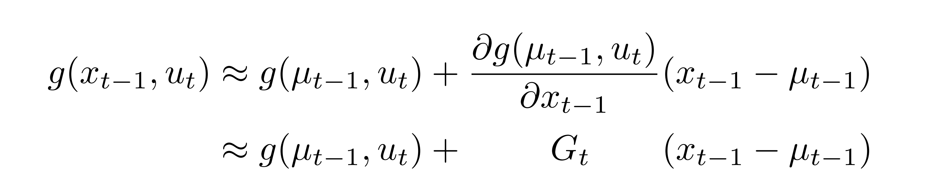
Kalman Filter Review
Extended Kalman Filter
Extension for nonlinear systems
Linearizes using Jacobians
Linearization using the Jacobian and Taylor Expansion [8]
[8] K. Kitani, “Extended Kalman Filter,” Computer Vision CMU. https://www.cs.cmu.edu/~16385/s17/Slides/16.4_Extended_Kalman_Filter.pdf/

Slide 13
Kalman Filter Review
Cascaded Kalman Filter
Alternative to augmenting states
Small computation amount
high data rate
strong real-time performance
Pros | Cons
Simpler | Sequential Processing
Modular | Complexity tuning
Computationally cheaper
[9] Y. Li, C. Liang, M. Lu, X. Hu, and Y. Wang, “Cascaded Kalman filter for target tracking in automotive radar,” The Journal of Engineering, vol. 2019, no. 19, pp. 6264–6267, Oct. 2019, doi: https://doi.org/10.1049/joe.2019.0159.

Slide 14
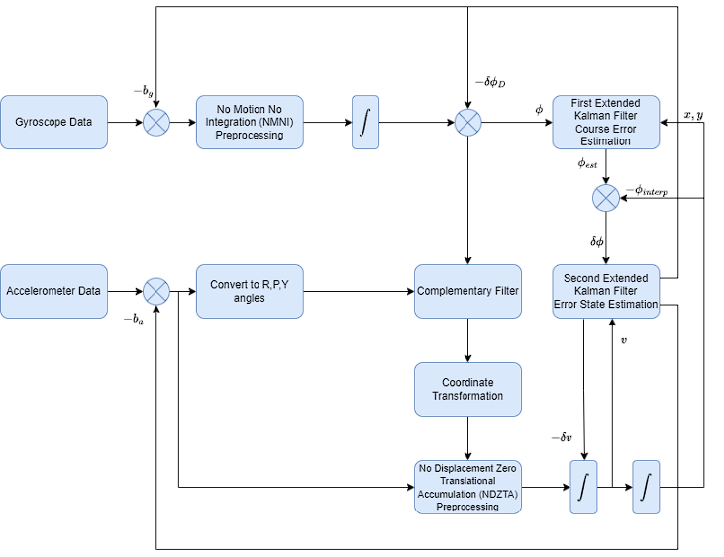
Overall Framework

Slide 15
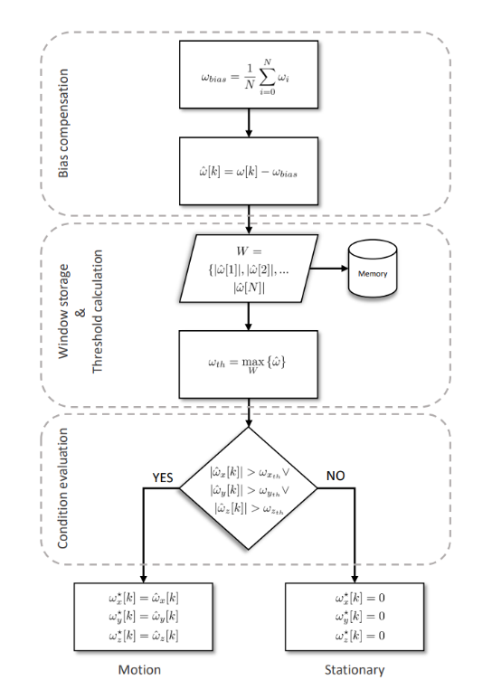
Preprocessing: NMNI
No Motion No Integration
Filters gyroscope data
Bias compensation
Store and update threshold
Check for motion
NMNI Flow chart [10]
[10] M. L. Hoang, A. Pietrosanto, S. D. Iancono, and V. Paciello, “Pre-Processing Technique for Compass-less Madgwick in Heading Estimation for Industry 4.0,” ieeexplore.ieee.org, Jun. 30, 2020.

Slide 16
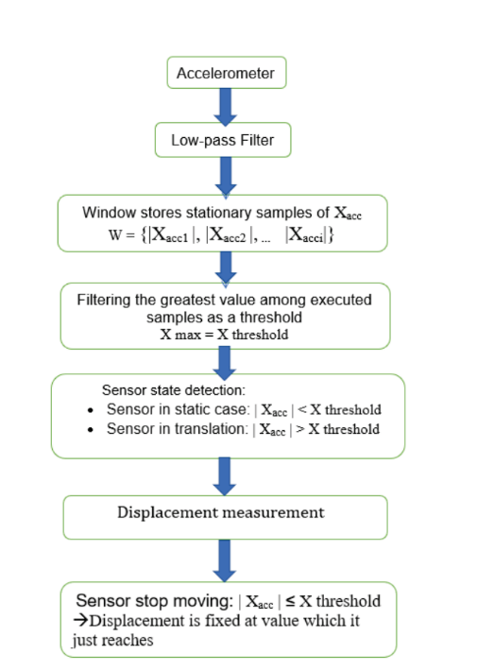
Preprocessing: NDZTA
No Displacement Zero Translational Accumulation
Filters accelerometer data
Low-pass Filter
Store and update threshold
Check for motion
NDZTA Flow Chart [11]
[11] M. L. Hoang, M. Carratu, M. A. Ugwiri, V. Paciello, and A. Pietrosanto, “A New Technique for Optimization of Linear Displacement Measurement based on MEMS Accelerometer,” ieeexplore.ieee.org, Nov. 30, 2020.

Slide 17
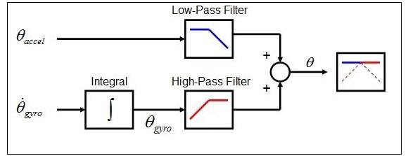
Pre-processing: Complementary Filter
Sensor fusion algorithm for orientation estimation
Complementary Filter Diagram [12]
[12] M. Shah, S. Bhargava, and S. B. K. Mr, “ Mission Planning and Waypoint Navigation of a Micro Quad Copter by Selectable GPS Co-Ordinates,” ResearchGate.

Slide 18
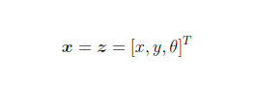
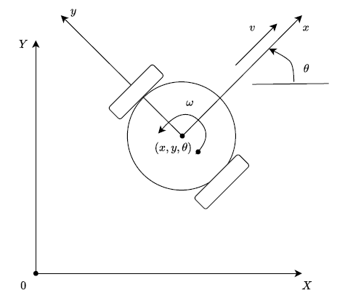
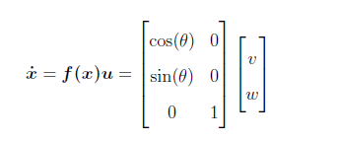
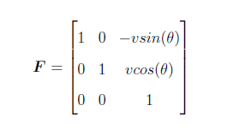
1st Kalman Filter (Mobile Robot): Process Model
Unicycle Model Mobile Robot
States and Measurements
X, Y, and heading
Unicycle Model Mobile Robot Diagram

Slide 19
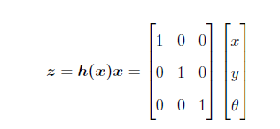
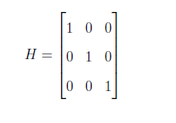
1st Kalman Filter (Mobile Robot): Measurement Model
Measurements are transformed externally

Slide 20
Overall Framework

Slide 21
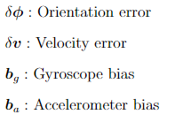
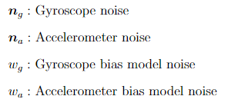
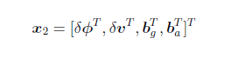
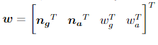
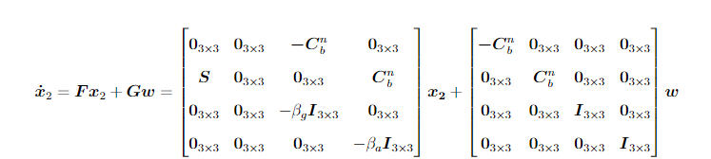
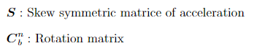
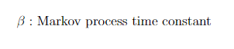
2nd Kalman Filter (IMU): Process Model

Slide 22
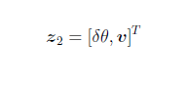
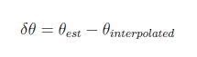
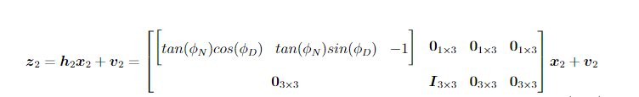
2nd Kalman Filter (IMU): Measurement Model
Measurements
Heading error
Velocity

Slide 23
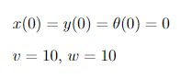
Simulation Results
Ground Truth
Generated from unicycle model kinematics
Testing with circular motion
Time: 0 - 4 sec with 20 ms refresh rate
Measurements generated from ground truth
Drift modeled

Slide 24
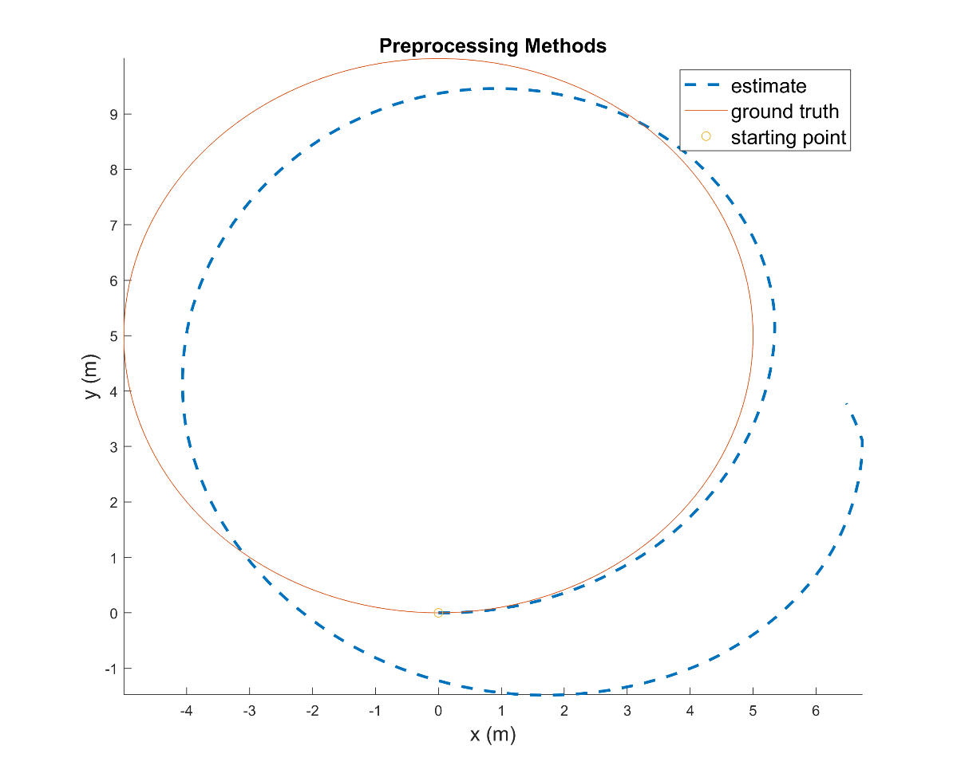
Simulation Results
Preprocessing methods only

Slide 25
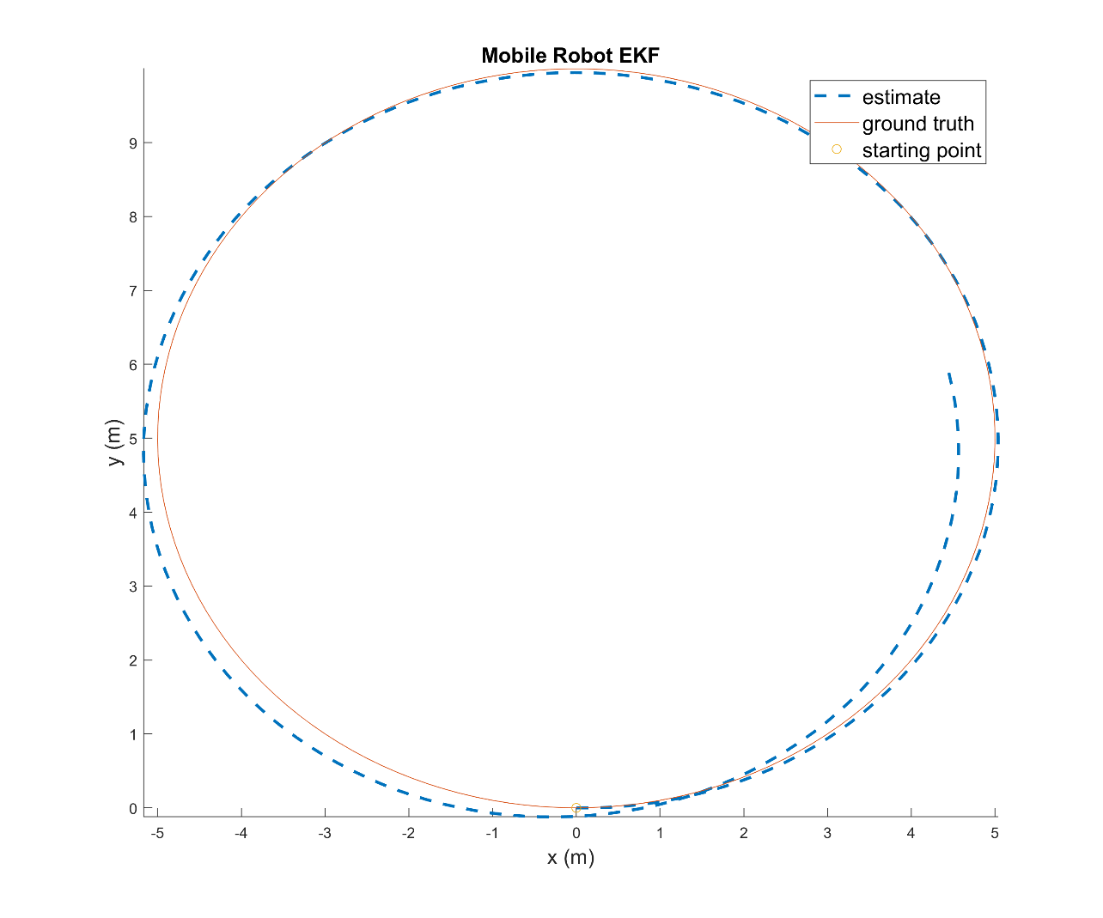
Simulation Results
EKF without error compensation

Slide 26
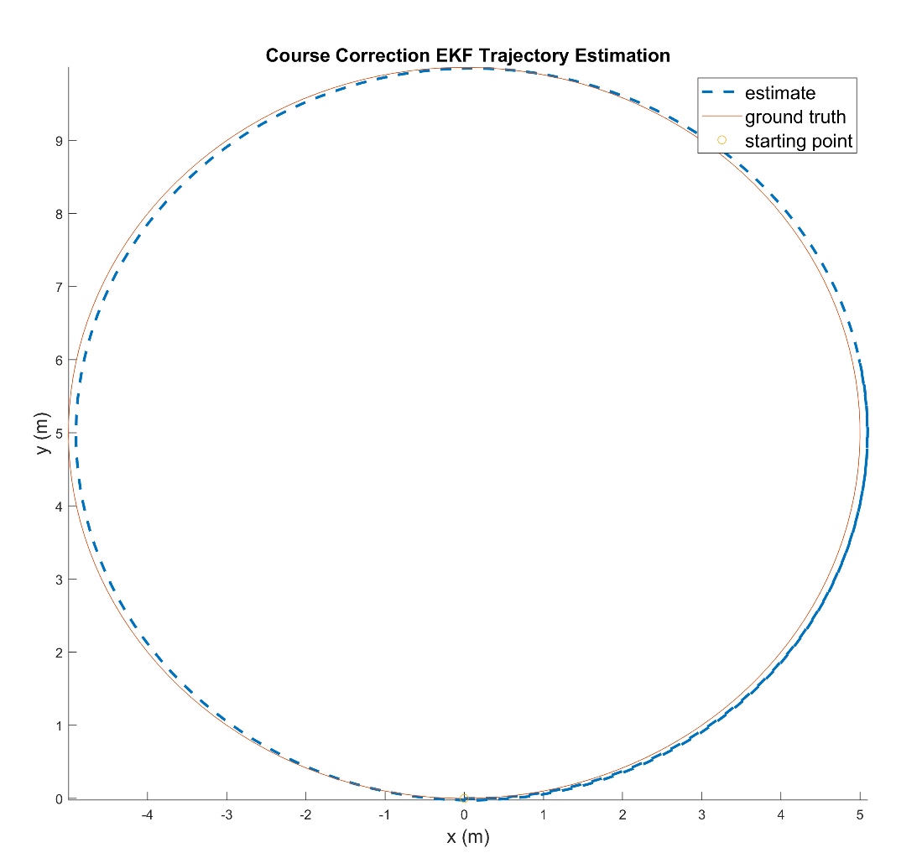
Simulation Results
Fully compensated trajectory estimation

Slide 27
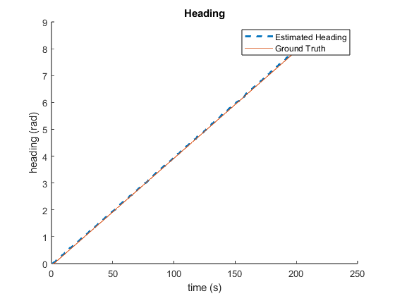
Simulation Results
Estimated heading

Slide 28
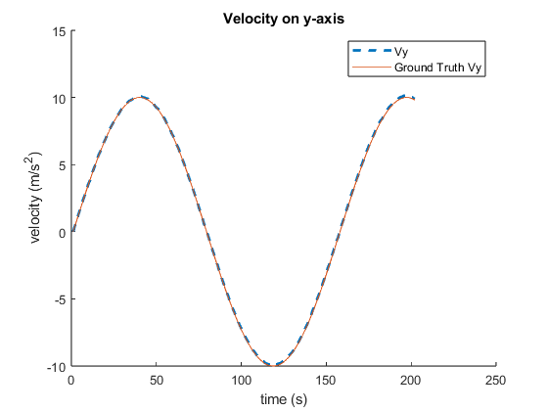
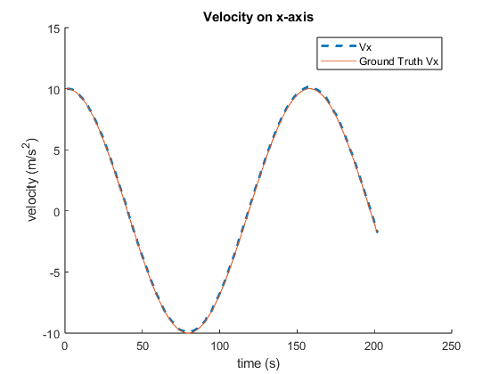
Simulation Results
Estimated velocity

Slide 29
Remaining Work
Fusion of optional additional sensor
Development in ROS Gazebo
Physical Implementation
Sphero-mini
Overhead camera for ground truth

Slide 30
Optional Sensor Block
Vision System
Provides position data
Minimize a cost function of squared errors
Either position or interpolated heading
Pass to 1st EKF (mobile robot)

Slide 31
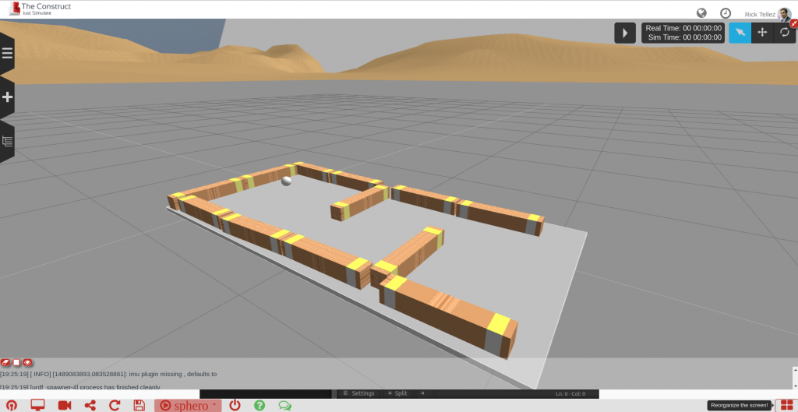
Gazebo Development
Develop algorithm without need for physical system
Easily transfer program to robot
Sphero is Gazebo Environment for Maze Navigation [13]
[13] R. Telez, “Developing ROS programs for the Sphero robot,” The Construct, Mar. 09, 2017. https://www.theconstructsim.com/developing-for-sphero/ (accessed Oct. 09, 2023).

Slide 32
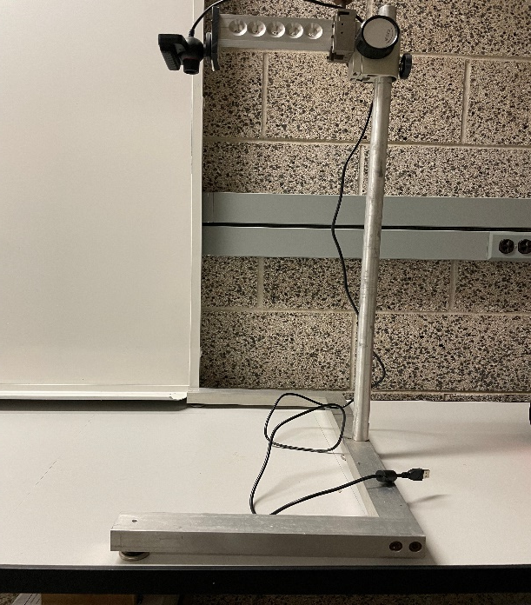

Physical implementation
Sphero-Mini
40 mm Diameter
6DOF IMU
Dual wheel drive
Sphero-Mini [14]
Vision system and workspace
[14] “Steam Education for All Ages & Stages.” STEM Kits & Robotics for Kids | Inspire STEM Education with Sphero, https://sphero.com/.

Slide 33
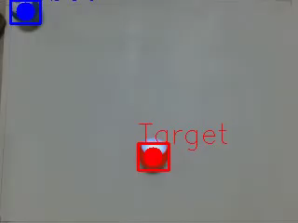
Physical Implementation
Vision-based control package created using ROS
Demonstration of Vision-Based Control Package with Sphero-Mini [15]
[15] T. Le, “sphero_ros_interaction,” GitHub, May 04, 2023. https://github.com/TaiLe2435/sphero_ros_interaction (accessed Oct. 09, 2023).

Slide 34
Potential Challenges
Slip in Sphero-mini
Interpolated heading error
ROS operating speed

Slide 35
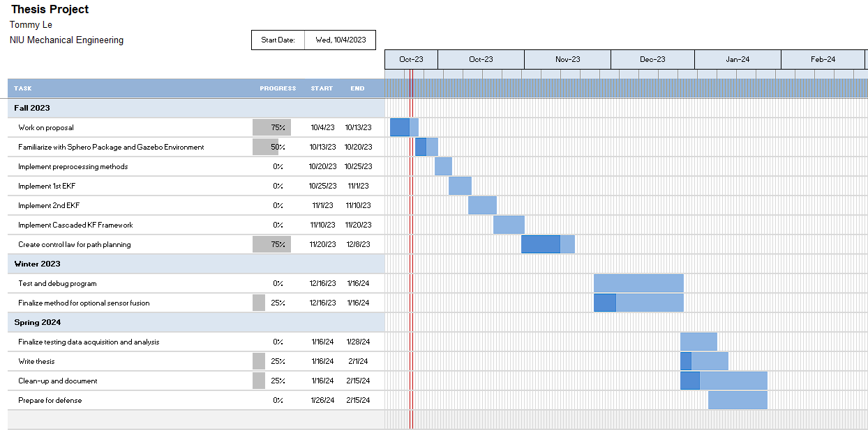
Timeline

